Slide 1
PIZZA SALES ANALYSIS
Project By:
Devang Kumawat
Data Analyst

Slide 2


INTRODUCTION
Fast-food chains and the broader food industry thrive on data-driven decisions to keep customers happy and profits high. That's where sales analysis comes in—it's absolutely critical for understanding what customers want, where revenue is coming from, and how the business is really performing.
This project dives into pizza sales data, using SQL to unlock key insights. We'll explore everything from typical order patterns to which pizzas are fan favorites and how much each category contributes to the bottom line.
With SQL's robust querying power, we'll connect the dots between individual orders, different pizza types, and the overall sales figures. This will arm businesses with the knowledge to pinpoint their best sellers, fine-tune their inventory, and design marketing campaigns that truly hit the mark.
My goal is to convert raw sales numbers into actionable intelligence that propels informed choices and drives business for

Slide 3

OBJECTIVE
I designed and completed a Pizza Sales Analysis project using SQL to provide crucial business insights and inform strategic decisions. My analysis involved complex SQL queries, utilizing multiple joins, aggregations, subqueries, and window functions, to extract detailed sales data. I calculated category-wise revenue contributions, total sales, and order frequencies, while also pinpointing top-selling pizza types and seasonal demand trends. I ensured data accuracy and optimized query performance for efficient analysis. The project culminated in a detailed report on revenue trends and customer preferences, offering valuable recommendations for inventory and marketing strategies.
Software - MYSQL Workbench

Slide 4

DATASET OVERVIEW
ORDERS
PIZZAS
ORDERS_DETAILS
PIZZA_TYPES

Slide 5


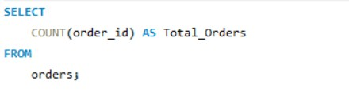
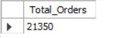
RETRIEVE THE TOTAL NUMBET OF ORDER PLACE

Slide 6
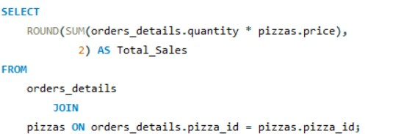
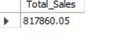
CALCULATE THE TOTAL REVENUE GENERATED FROM PIZZA SALES

Slide 7
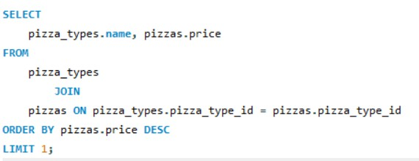
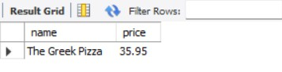
IDENTIFY THE HIGHEST PRICE PIZZA

Slide 8
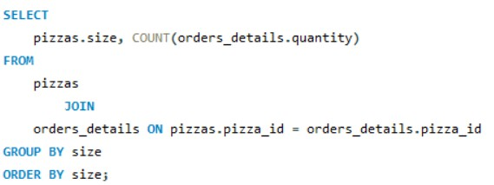
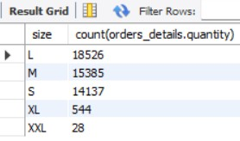
IDENTIFY THE MOST COMMON PIZZA SIZE ORDERED

Slide 9
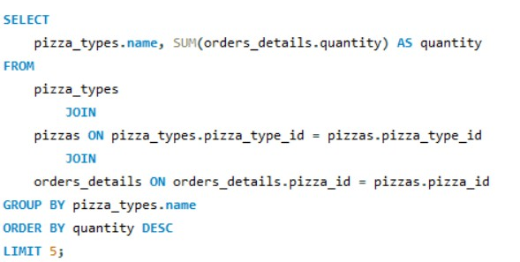
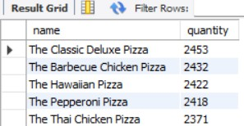
IDENTIFY THE MOST COMMON PIZZA SIZE ORDERED

Slide 10
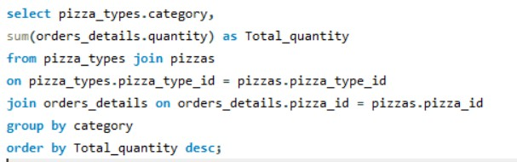
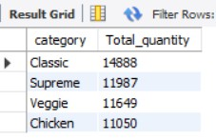
JOIN NECESSARY TABLE TO FIND THE TOTAL QUANTITY OF EACH PIZZA CATEGORY ORDERED

Slide 11
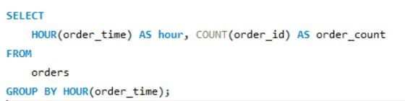
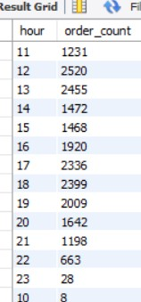
DETERMINE THE DISTRIBUTION OF ORDERS BY HOUR IN A DAY

Slide 12
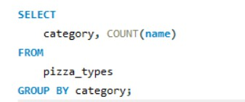
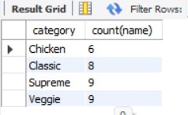
JOIN THE RELEVANT TABLES TO FIND THE CATEGORY-WISE DISTRIBUTION OF PIZZAS

Slide 13

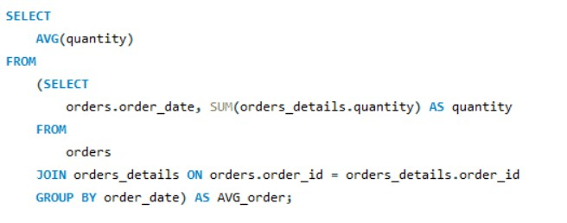
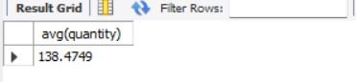
GROUP THE ORDERS BY DATE AND CALCULATE THE AVERAGE NUMBER OF PIZZASORDERED PER DAY

Slide 14
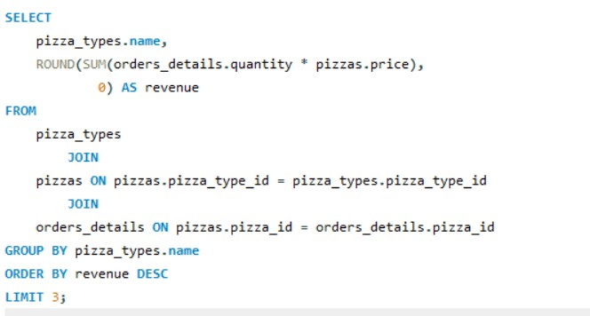
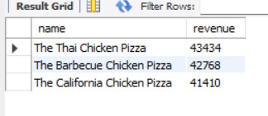
GROUP THE ORDERS BY DATE AND CALCULATE THE AVERAGE NUMBER OF PIZZASORDERED PER DAY

Slide 15
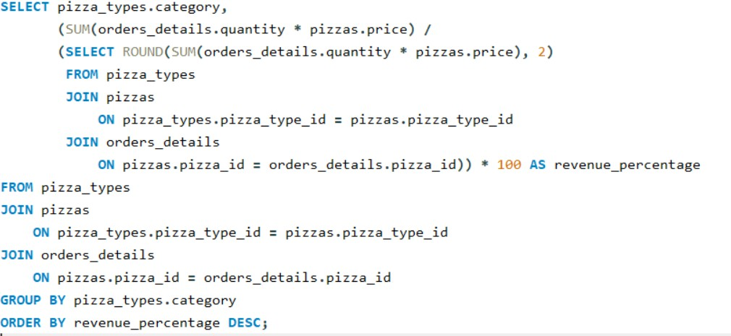
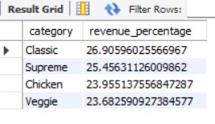
CALCULATE THE PERCENTAGE CONTRIBITION OF EACH PIZZA TYPE TO TOTAL REVENUE

Slide 16
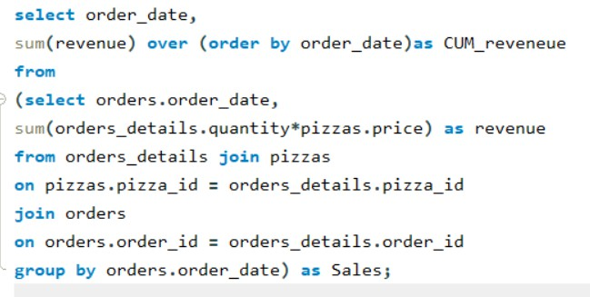
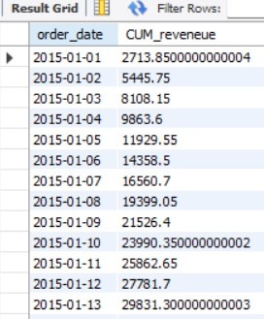
ANALYZE THE CUMULATIVE REVENUE GENERATED OVER TIME

Slide 17
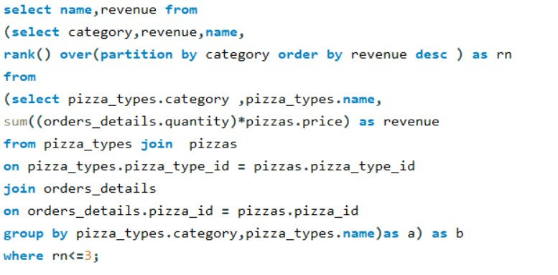
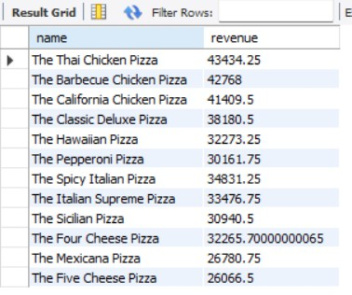
DETERMINE THE TOP 3 MOST OR EDR PIZZA TYPES BASED ON REVENUE FOR EACH
PIZZA CATEGORY

Slide 18
CONCLUSION
The Pizza Sales Analysis project provided valuable insights into sales performance and product demand through efficient SQL-based data exploration and analysis. By analyzing order details, revenue distribution, and category-wise sales, we identified top-performing pizza types and their contribution to overall business revenue. This analysis helps in understanding customer preferences, enabling better inventory management and more effective marketing strategies.
Furthermore, the project demonstrated the importance of SQL in extracting and transforming data to generate meaningful business insights. The approach used in this project can be extended to identify seasonal sales trends, optimize pricing strategies, and forecast future demand. With advanced visualizations and deeper customer segmentation, this analysis can evolve into a comprehensive business intelligence solution.

